Slide 1






.
BLDEA'S SHREE SANGAN BASAVA MAHA SWAMIJI PLOYTECHIC VIJAYAPUR
SEMESTER END
EAMINATIONS
POOJA RAJSHEKHAR ARABI
393CS20020

Slide 2
Table of Content
1
2
3
4
5
6
Company
discription
On Job
Training-1
Use
case-1
On Job Training-2
Use
Case -2
conclustion

Slide 3


about company
TECHIFY INDIA
TechifyIndia company design and build innovative IoT products for everyone that will help to improve efficiency ,quality ,accuary and precision and bring down costs.
TechifyIndia company is product base company. It provide it’s won product
This company is customer side production company.
Since 2017, the company have been providing consulting service, website development, design services, IoT, application development and technical support to clients in various industries, whereas clients have extensive. opportunity to select the service of their chance to satisfy their digital needs.
Get control get techify

Slide 4
Vision, Mission
TECHIFY INDIA
MISSION of the organization is, To produce excellent services in the field of IT Services and Consultancy with maximum efforts driven towards customer satisfaction.
To provide and develop innovative and high quality products , services and solution which offer the best value to customers.
Vision
VISION is to build upon a reputation of being one of the most innovative IT Solution and Service provider.
Company main focus is Customers and partner’s Success.
Company visionary and experienced team turns innovation ideas into effective products and software.
Mission

Slide 5

Techify India
Organization Structure
It is characterized by the division of the company into different functional areas, such as marketing, finance, operations, and human resources.
Each functional area is headed by a manager who oversees the activities of their team. This structure is simple and efficient.
The executive team consists of 12 members, with the CEO being the highest-ranking member of the organization.

Slide 6

Techify India
ROLES AND RESPONSIBLITIES OF PERSONNELIN ORGANIZATION:
It is characterized by the division of the company into different functional areas, such as marketing, finance, operations, and human resources.
Each functional area is headed by a manager who oversees the activities of their team. This structure is simple and efficient.
The executive team consists of 12 members, with the CEO being the highest-ranking member of the organization.

Slide 7
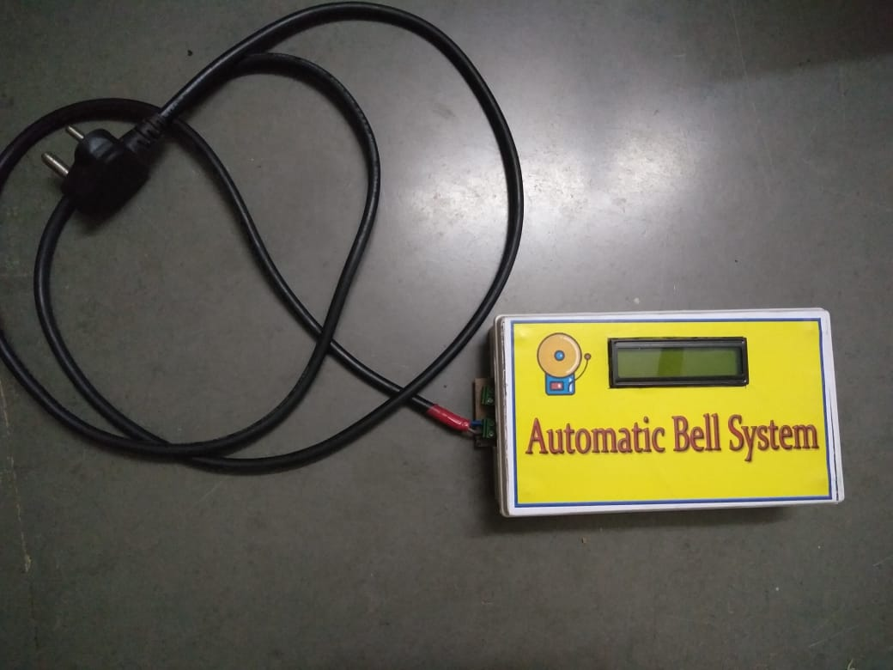



Techify India
PRODUCTS AND MARKET PERFORMANCE
TECHIFYINDIA Software Solution’s strength lies in understanding the client’s business processes, culture, vision and goals across the industry segments and offering client oriented solutions which are highly reliable, creating customer comfort. Few of our products are listed below.
CashewSoft ERP
IOT Based Smart Bell, etc.
TAX-E(GST Billing)
CNC Monitoring

Slide 8
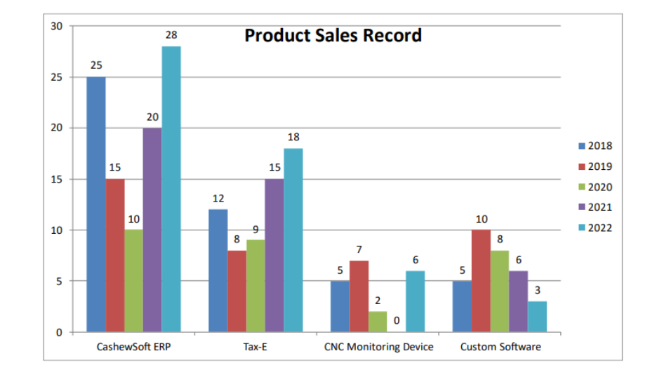
Techify India

Slide 9
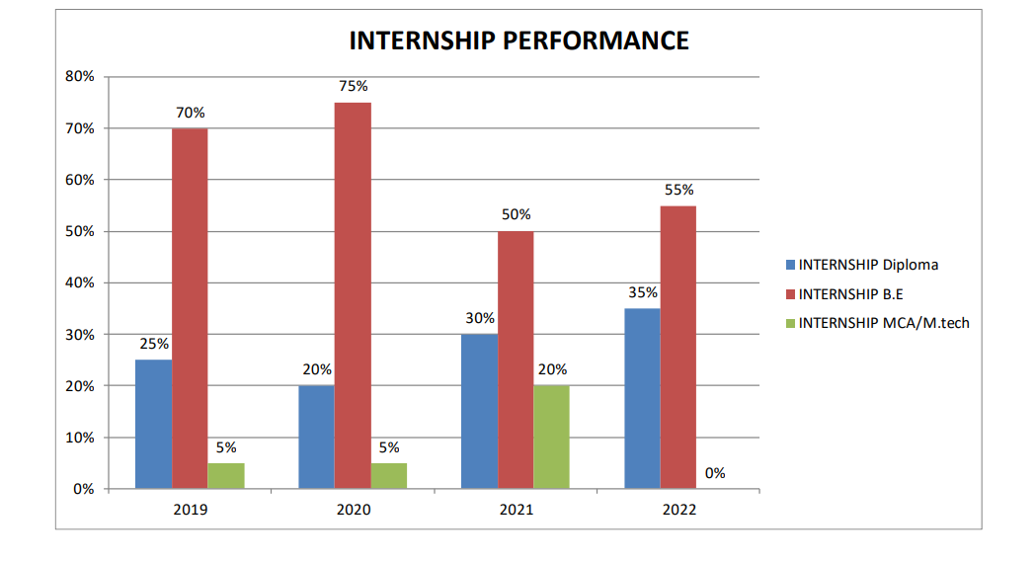
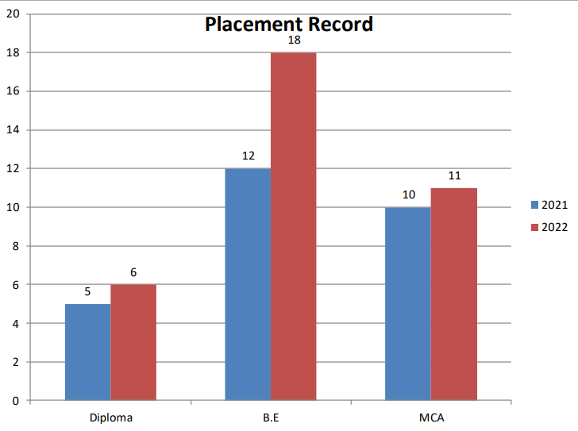
Techify India
INTERNSHIP PERFORMANCE AND PLACEMENT RECORD
•

Slide 10


Techify India

Slide 11
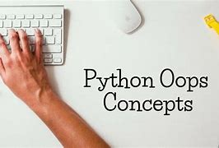
OJT-1
Python Programming with OOPs
It was created by Guido van Rossum and first released in 1991.
Python is a high-level, interpreted programming language that emphasizes code readability and simplicity.
Python is a versatile and popular programming language known for its simplicity and readability.
Object-Oriented Programming is a powerful approach to software development that focuses on organizing code into reusable objects, enabling modular and maintainable code.

Slide 12
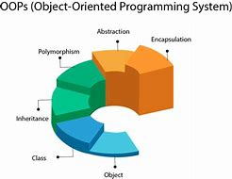
OJT-1
Object-Oriented Programming (OOP)
Object-Oriented Programming is a programming paradigm that provides a structured way to design and build software.
Classes and Objects: In OOP, a class represents a real-world entity or concept. It defines the structure and behavior that objects of that class will possess. And To create a class in Python, you use the class keyword followed by the class name. Within the class, you can define attributes (data variables) and methods (functions) that describe the behavior of objects created from that class.
Encapsulation:Encapsulation is a fundamental principle of OOP that combines data and functions into a single unit called a class. It allows you to hide the internal details of a class and provide controlled access to the class members.
Inheritance: Inheritance is a mechanism that allows a class to inherit attributes and methods from another class, called the base class or parent class. The class inheriting from the base class is called the derived class or child class.
Polymorphism: Polymorphism is the ability of objects of different classes to be treated as objects of a common base class.

Slide 13
OJT-1
Implementation of OOP in Python
Class Definition: In Python, a class is defined using the class keyword followed by the class name and a colon. The class body is indented, and it contains attribute and method definitions.
constructor is a special method that is automatically called when an object is created from a class. In Python, the constructor method is named __init__()is used to Internship on Artificial Intelligence and Machine Learning initialize the attributes of the object.A destructor method, __del__(), can be defined to perform cleanup operations before an object is destroyed and memory is released.
Method Overriding:-In Python, this is achieved by defining a method with the same name in the derived class. When the method is called on an object of the derived class, the overridden method in the derived class is executed instead of the base class method.
Method Overloading: Python does not support method overloading in the traditional sense, where multiple methods with the same name but different parameters are defined.achieve similar functionality by using default parameter values or variable-length arguments.
Method Overriding

Slide 14
OJT-1
Benefits of OOP in Python
Reusability: OOP promotes reusability by allowing the creation of reusable objects and classes.
Modularity: O.OP enables the modular organization of code.
Classes encapsulate data and related methods into self-contained units.
Flexibility and Extensibility: Inheritance, a key feature of OOP, allows for easy modification and extension of existing code. New classes can be created that inherit and reuse the functionality of base classes.
Encapsulation, a core principle of OOP, encapsulates data and methods within a class, hiding the internal implementation details.
. Improved Code Organization and Design: OOP promotes better code organization and design by providing clear structures for managing complexity
Polymorphism and Code Flexibility: Polymorphism, another important concept in OOP, allows objects of different types to be treated uniformly based on their shared interface or behavior.
Improved Collaboration and Code Maintenance: OOP facilitates collaboration among developers in large-scale projects. By dividing the project into classes and objects, different team members can work on different parts of the project independently

Slide 15
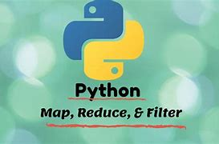
Important Functions of Python
OJT-1
Map: The map() function in Python is used to apply a given function to each item in an iterable (such as a list) and returns an iterator containing the results.
The map() function takes each item from the iterable, applies the function to it, and returns an iterator that yields the results.
Filter: It returns an iterator that contains the elements for which the condition is True.
The filter() function applies the function to each element in the iterable and retains only the elements for which the function returns True.
Reduce: The reduce() function is part of the functools module in Python. It is used to apply a specified function to the elements of an iterable in a cumulative way. The reduce() function performs a repetitive operation on pairs of elements until a single value is obtained.

Slide 16
USECASE-I
Problem Statement
You are tasked with creating a simple banking application. Implement a Python class called BankAccount that represents a bank account. The BankAccount class should have the following attributes and methods:
Attributes:
account_number (integer): A unique identifier for the bank account.
balance (float): The current balance in the account.
Methods:
__init__(self, account_number): Initializes a new bank account with the given account number and a balance of 0.
deposit(self, amount): Deposits the specified amount into the account and updates the balance accordingly.
Withdraw(self, amount): Withdraws the specified amount from the account, if the account has sufficient funds, and updates the balance accordingly.
get_balance(self): Returns the current balance in the account.
Write the BankAccount class implementation and provide a sample code snippet that demonstrates the usage of the class by creating instances of BankAccount and performing various operations on them.
Feel free to add any additional helper methods or attributes to enhance the functionality of the BankAccount class if you wish.

Slide 17
UseCase-1
Need for bank management system
Efficient account management: A bank deals with a large number of customer accounts. A management system allows banks to create and maintain customer accounts, update customer information, track account activities, and generate statements.
Transaction processing:: A management system automates and streamlines these transactions, improving efficiency, reducing processing time, and minimizing errors.
Customer service enhancement:It allows customer inquiries, complaint handling, and support requests to be efficiently managed and tracked.
Security and compliance:A management system incorporates robust security measures, including data encryption, access controls, and fraud detection mechanisms, to protect customer data and ensure compliance with regulatory requirements.
Reporting and analytics:It allows banks to monitor performance, track key metrics, and make data-driven decisions.

Slide 18
UseCase-1
AI Implementation
AI, or Artificial Intelligence, refers to the development and implementation of computer systems that can perform tasks that would typically require human intelligence. AI aims to create intelligent machines that can simulate human cognitive abilities such as problemsolving, learning, reasoning, perception, and decision-making.
This program demonstrates user interaction through a simple banking system. Here's how the user interacts with the program:
The user is prompted to enter the number of bank accounts to create.
For each account, a random account number is generated, and an account object is created.
The program displays the created account number.
The user is then asked to select a bank account by entering its index.
If the entered index is invalid, an error message is displayed, and the program breaks.
If a valid index is entered, the selected account's number and balance are displayed.
The program enters a while loop to present a menu of options to the user:Deposit, Withdraw, Check Balance, or Exit.
The user is prompted to enter a choice (1-4) based on the menu options.
Depending on the user's choice, the program performs the corresponding action:
If choice 1 is selected, the user is prompted to enter a deposit amount, and the amount is added to the account's balance.
If choice 2 is selected, the user is prompted to enter a withdrawal amount, and the amount is subtracted from the account's balance. 12. If choice 3 is selected, the account's updated balance is displayed.
If choice 4 is selected, the program exits the loop and ends.
If an invalid choice is entered, an error message is displayed.
The loop continues until the user chooses to exit (choice 4)

Slide 19
USECASE-I
Explanation
The code you provided seems to implement a simple bank account management system using the account class. Here's a breakdown of how the code works:
The account class is defined, which represents a bank account. It has attributes like account_number and balance, initialized in the constructor (__init__ method).
The deposite method allows depositing an amount into the account. It checks if the amount is valid and updates the account balance accordingly.
The withdraw method enables withdrawing an amount from the account. It verifies if the amount is valid and checks if there are sufficient funds in the account before deducting the withdrawal amount from the balance.
The get_balance method simply returns the current balance of the account.
The code prompts the user to enter the number of bank accounts to create and stores them in a list l. Each account is created using the account class, with a randomly generated account number.
For each account in the list, the user is asked to select a bank account. The account number is displayed along with the current balance.
The user is presented with a menu of options: deposit, withdraw, check balance, or exit. Based on the chosen option, the corresponding method of the selected account is called.
The process continues until the user chooses to exit the program.

Slide 20
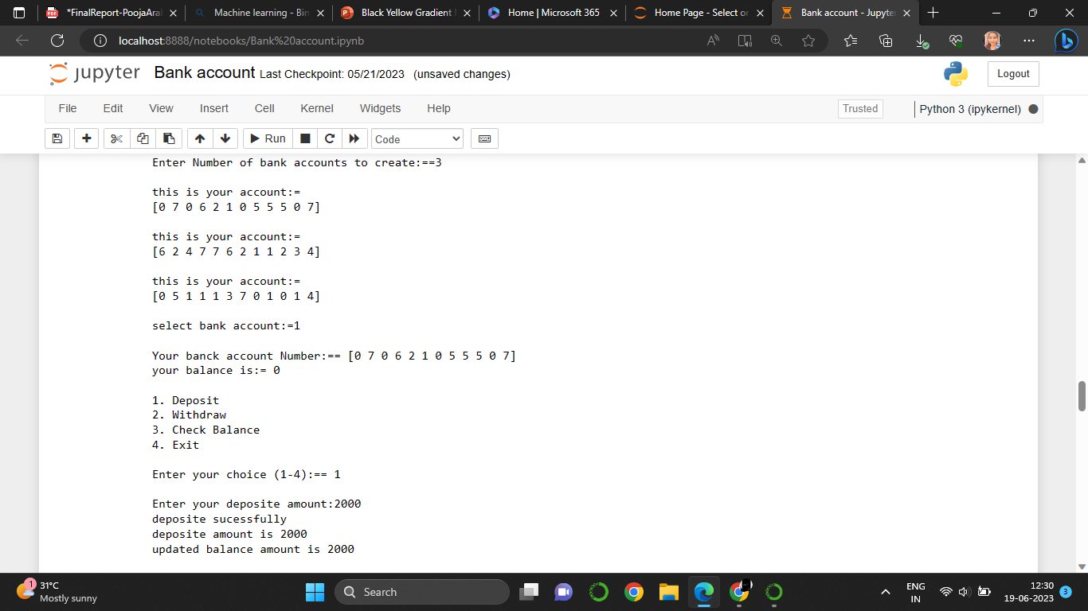
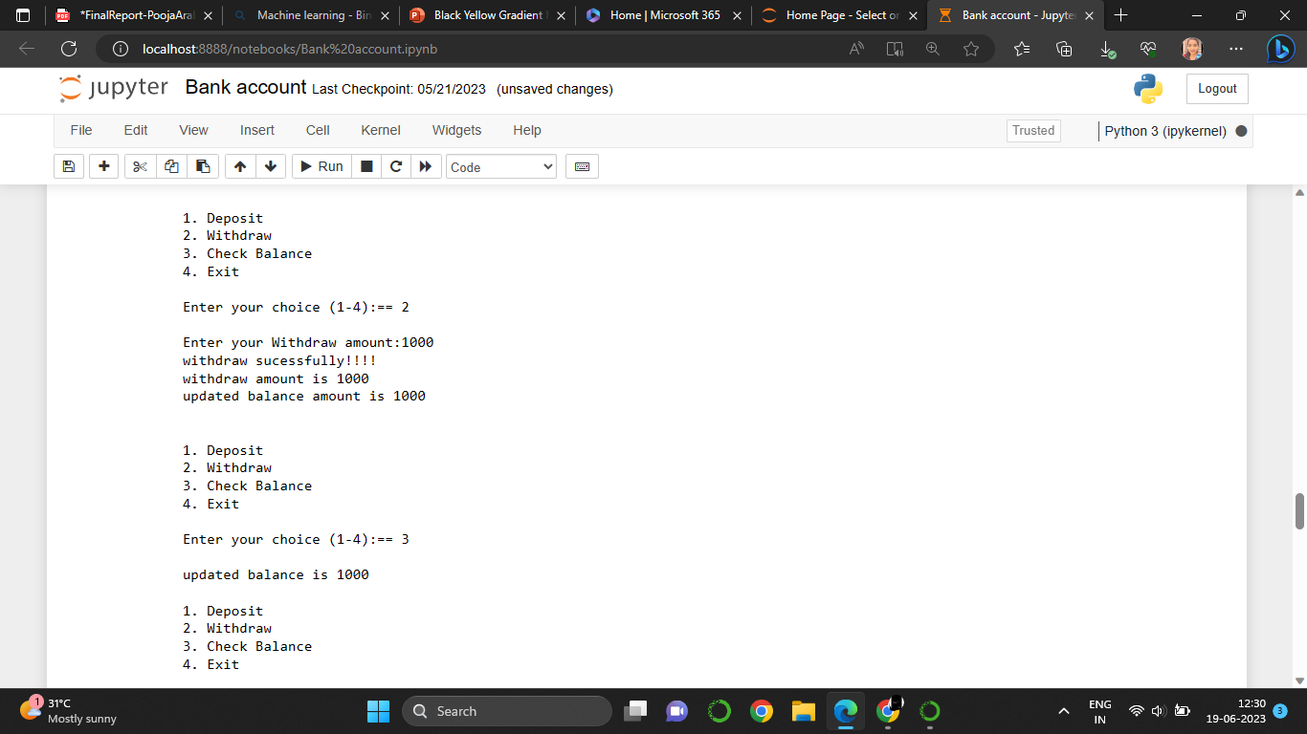
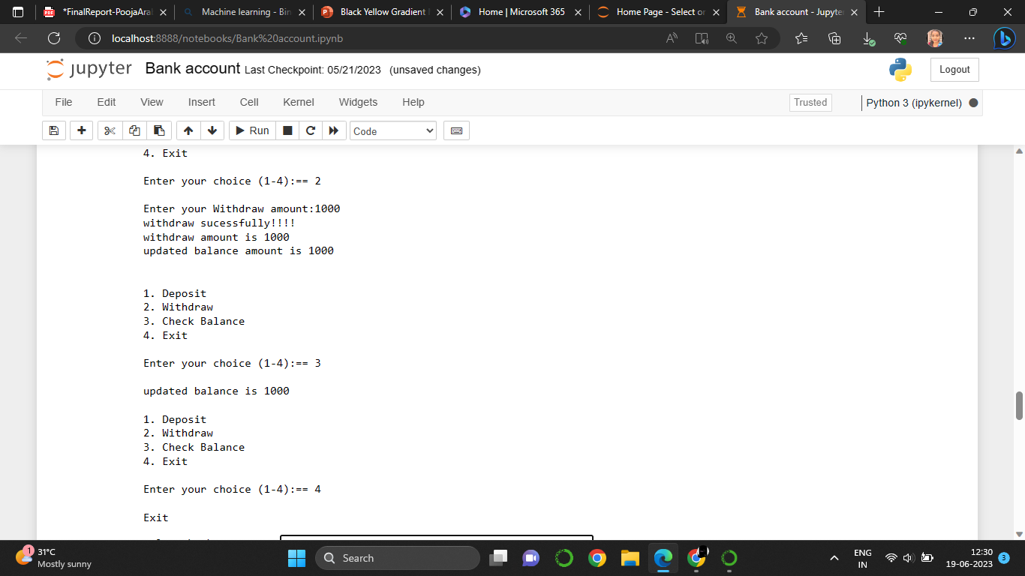
USECASE-I
OUTPUT

Slide 21

OJT-II
Artifical Intelligence
Artificial Intelligence is composed of two words Artificial and Intelligence, where Artificial defines "man-made," and intelligence defines "thinking power", hence AI means "a man-made thinking power."
1. Artificial Intelligence is now all around us. It is currently working with a variety of subfields, ranging from general to specific, such as self-driving cars, playing chess, proving theorems, playing music, Painting, etc.
2. "It is a branch of computer science by which we can create intelligent machines which can behave like a human, think like humans
3. Artificial Intelligence (AI) is a field of computer science that focuses on creating intelligent machines capable of performing tasks that would typically require human intelligence. It involves the development of algorithms, models, and systems that can learn, reason, perceive, and make decisions to solve problems or achieve specific goals.

Slide 22

OJT-II
Machine Learning
Definition: Machine Learning is a subfield of artificial intelligence (AI) that focuses on developing algorithms and models that enable computers to learn and make predictions or decisionswithout being explicitly programmed.
Learning from Data: ML algorithms learn from large amounts of data, which is used to identify patterns, extract meaningful insights, and make predictions or take actions based on that learning.
Training Phase: ML models are trained using labeled data, where the desired outcome or output is known. The model learns to map input data to the correct output by adjusting its internal parameters through an iterative process.
Feature Extraction: ML algorithms typically require relevant features or characteristics from the input data to make accurate predictions. Feature extraction involves selecting, transforming, or engineering the most informative features from the raw data.

Slide 23

OJT-II
Computer Vision
Computer vision is a field of artificial intelligence and computer science that focuses on enabling computers to interpret, analyze, and understand visual information from images or videos.
Here's a detailed description of computer vision: 1. Understanding Visual Data: Computer vision aims to enable computers to understand and interpret visual data, such as digital images or videos.
Image Processing:It involves manipulating and enhancing digital images to improve their quality, extract features, remove noise, perform filtering operations, and prepare them for further analysis.
Feature Extraction: Feature extraction is a crucial step in computer vision. It involves identifying and extracting relevant features or characteristics from images or videos.
. Object Recognition and Detection: Object recognition is the process of identifying and classifying specific objects or instances within an image or video.

Slide 24
OJT-II
OpenCV
Open CV:= OpenCV (Open-Source Computer Vision Library) is an open-source computer vision and machine learning software library. It provides a wide range of tools, functions, and algorithms that enable developers to process, analyze, and understand visual data, such as images and videos.
Purpose: OpenCV is primarily used for computer vision tasks, which involve extracting meaningful information from visual data
Open-Source: OpenCV is an open-source library, which means that its source code is freely available to the public.
Cross-Platform: OpenCV is designed to work on different operating systems, including Windows, macOS, Linux, Android, and iOS. It provides a unified API (Application Programming Interface) across platforms.
Wide Language Support: OpenCV originally started as a C++ library but now supports multiple programming languages, including Python, Java, and MATLAB/Octave

Slide 25

UseCase-II
Smart City Project
A smart city project refers to an initiative that leverages advanced technologies and data-driven solutions to improve the quality of life, sustainability, efficiency, and overall functioning of a city.
Infrastructure: Smart cities focus on developing or upgrading infrastructure with smart features, such as intelligent transportation systems (ITS), smart grids, energy-efficient buildings, and high-speed internet connectivity.
Data and Technology: They rely on data collection through sensors, Internet of Things (IoT) devices, and other sources to gather real-time information about various aspects of the city.
Sustainable Development: Smart cities emphasize environmental sustainability by implementing eco-friendly practices, such as renewable energy generation, energyefficient lighting, waste management systems, and green spaces.
Citizen Engagement::=Projects often involve community input, feedback mechanisms, Internship on Artificial Intelligence and Machine Learning and the use of digital platforms to connect residents with city authorities, allowing them to voice concerns, access services, and contribute to decisionmaking processes.

Slide 26
OJT-II
Problem Statement
Import the necessary libraries: cv2 and pytesseract.
2. Set the path to the Tesseract executable using pytesseract.pytesseract.tesseract_cmd.
3. Load the trained cascade classifier for number plate detection using cv2.CascadeClassifier.
4. Define a function recognize_number_plate that takes an image as input and performs the following steps: • Convert the image to grayscale. • Apply Gaussian blur to reduce noise. • Use Tesseract OCR to extract the text from the image • Return the extracted text.
5. Read an input image using cv2.imread.
6. Convert the image to grayscale using cv2.cvtColor. 7. Use the cascade classifier to detect number plates in the image using plate_cascade.detectMultiScale with specified parameters (scaleFactor, minNeighbors, minSize).
8. Iterate over the detected number plate regions and perform the following steps
• Draw a rectangle around each detected number plate using cv2.rectangle.
• Extract the region of interest (number plate) from the image.
• Convert the region to grayscale using cv2.cvtColor.
• Apply Tesseract OCR to recognize the number plate text, using the --psm configuration option.
• Display the detected number plate text using cv2.putText.

Slide 27
UseCase-II
Needs for car numberplate detection
Number plate detection, also known as license plate recognition (LPR) or automatic number plate recognition (ANPR), is a technology that is used to read and extract information from vehicle license plates.
Law Enforcement: Number plate detection is extensively used by law enforcement agencies to identify and track vehicles involved in criminal activities.
Traffic Management: Number plate detection helps in monitoring and managing traffic flow.
Parking Systems: In parking lots or garages, number plate detection is employed to automate entry and exit procedures.
Toll Collection: Number plate detection is utilized in electronic toll collection systems.
Security and Surveillance: Number plate detection can be used in security systems to monitor and track vehicles in sensitive areas such as airports, government facilities, or private premises.

Slide 28
UseCase-II
Explanation
Feature Extraction: ML algorithms typically require relevant features or characteristics from the input data to make accurate predictions. Feature extraction involves selecting, transforming, or engineering the most informative features from the raw data.
CV2: library for computer vision and image processing tasks in Python. It provides a wide range of functions and algorithms that enable developers to perform various operations on images and videos.
pytesseract.pytesseract.tesseract_cmd: In the context of pytesseract, pytesseract.pytesseract.tesseract_cmd is a configuration variable that represents the path to the Tesseract OCR executable on your system.
CascadeClassifier: The CascadeClassifier is a class in the OpenCV library that is used for object detection.
Haarcascade:It is a popular and efficient method for detecting objects in images or video frames. A Haar cascade is a series of classifiers trained to detect specific visual features in an image.
CvtColor:cvtColor is a function in the OpenCV library that is used to convert an image from one color space to another.
GaussianBlur: GaussianBlur is a function in the OpenCV library that is used to apply Gaussian smoothing or blurring to an image.
pytesseract.image_to_string:=pytesseract.image_to_string is a method provided by the pytesseract library that allows you to extract text from an image

Slide 29
UseCase-II
imread :=imread is a function in the OpenCV library that is used to read an image from a file and load it into a numpy array.
COLOR_BGR2GRAY: COLOR_BGR2GRAY is a color conversion code used in OpenCV to convert an image from the BGR (Blue-Green-Red) color space to grayscale.
plate_cascade.detectMultiScale: Theplate_cascade.detectMultiScale method is used to detect license plates in an image or video frame using a cascade classifier specifically trained for license plate detection.
FONT_HERSHEY_SIMPLEX:FONT_HERSHEY_SIMPLEX is a font type used in OpenCV for adding text to images or video frames.
imshow :=imshow is a function in the OpenCV library used to display an image or video frame in a window.
. waitKey :=waitKey is a function in the OpenCV library used to introduce a delay and wait for a keyboard event in a graphical user interface (GUI)
window.DestroyAllWindows:= destroyAllWindows is a function in the OpenCV library that is used to close all currently open windows created using the imshow function

Slide 30
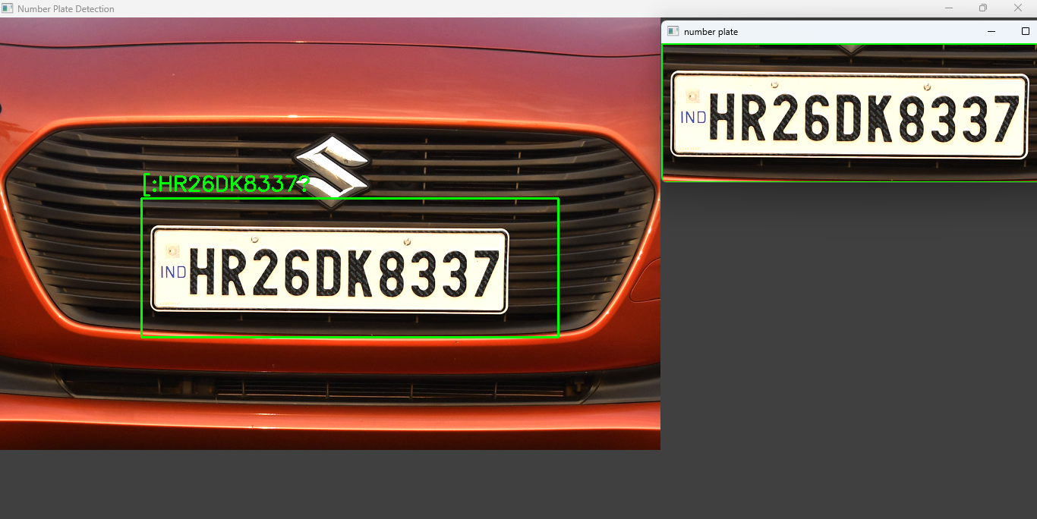

UseCase-II
OUTPUT

Slide 31
Thank You

